Slide 1
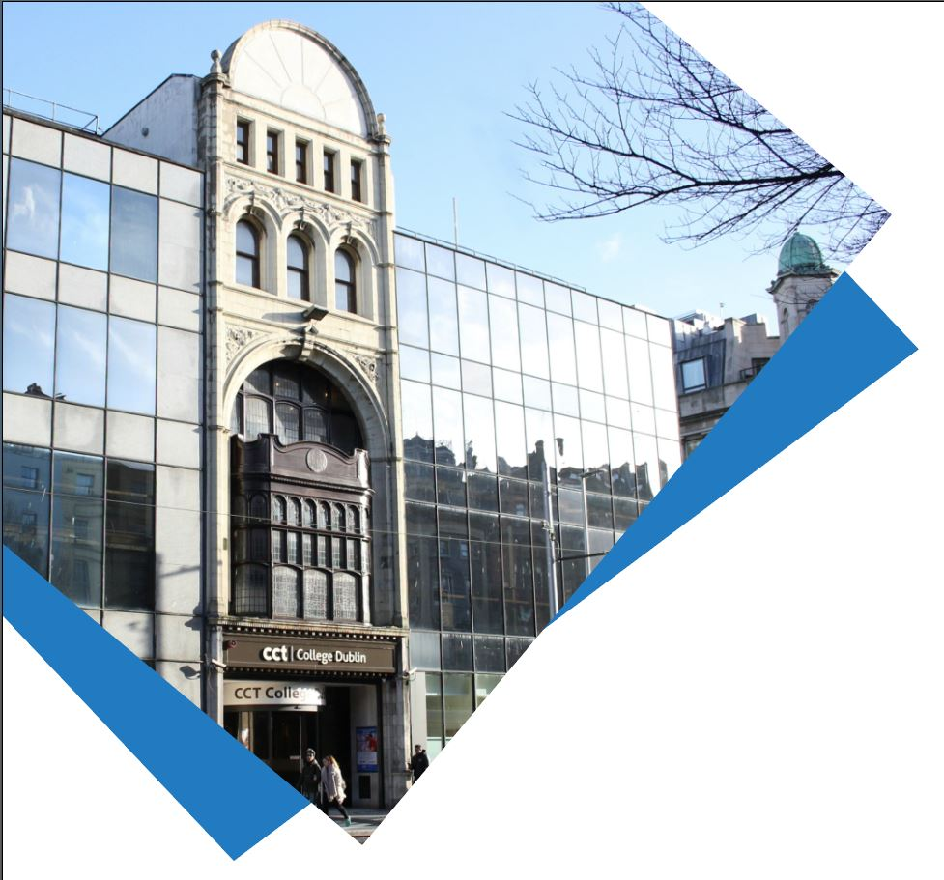
Machine Learning for Data Analysis MSc in Data Analytics CCT College Dublin
Introduction to Machine Learning
Week 1
Lecturer: Dr. Muhammad Iqbal*
Email: miqbal@cct.ie

Slide 2
Agenda
Introduction to Machine Learning (ML)
Traditional Programming and Machine Learning
What is Machine Learning?
Application Areas of ML
Branches of Machine Learning
Supervised, Unsupervised, Semi-supervised and Reinforcement Learning
ML Algorithm Selection
Cross Industry Standard Process (CRISP-DM)

Slide 3
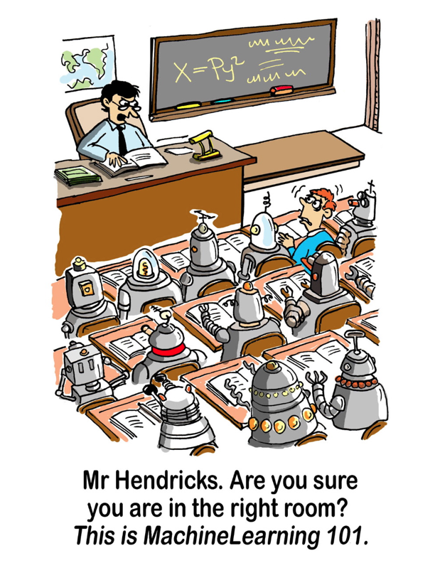

Slide 4
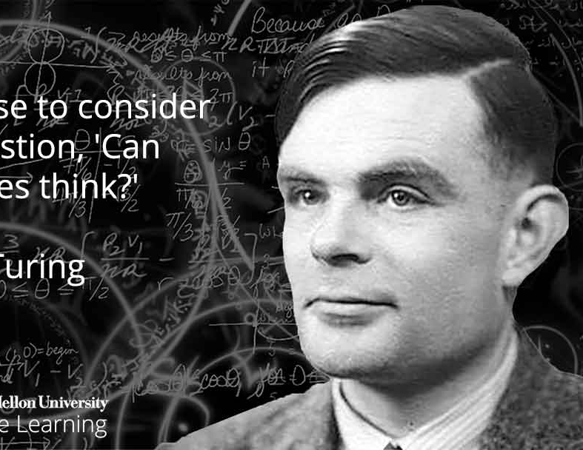
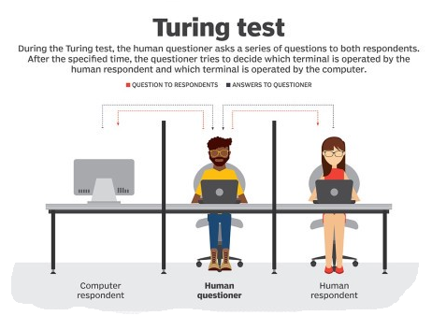
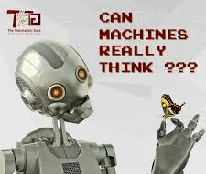
Introduction to ML
In 1950, Alan Turing asked a question in his paper, “Computing Machinery and Intelligence”,
“Can machines think?” or “Can machines behave intelligently?”
The paper describes the “Imitation Game,” which involves three participants, such as a human acting as a judge, another human, and a computer that is attempting to convince the judge that it is human.
The judge would type into a terminal program to “talk” to the other two participants. Both the human and the computer would respond, and the judge would decide which response came from the computer.
If the judge couldn’t consistently tell the difference between the human and computer responses, then the computer won the game. The test continued in the form of the Loebner Prize, until 2019.
The aim is simple enough: convince the judges that they are chatting to a human instead of a computer chat bot program.
Notes:
https://www.csee.umbc.edu/courses/471/papers/turing.pdf
https://en.wikipedia.org/wiki/Loaner_Prize#Competition_rules_and_restrictions

Slide 5
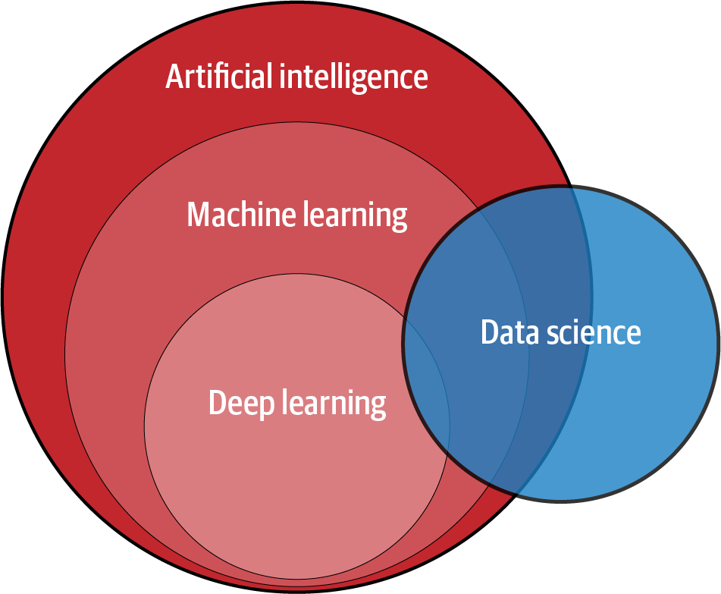
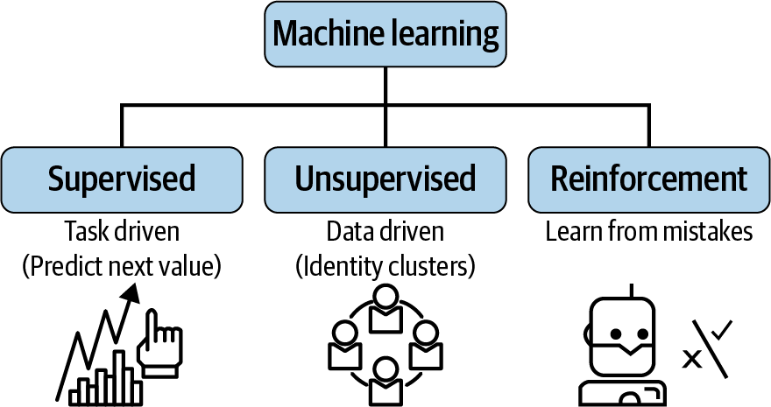
Introduction to Machine Learning
We can observe from the figure that the relationships between AI, machine learning, deep learning and data science overlapping.
Machine learning is a subset of AI that consists of techniques enabling computers to identify patterns in data and to deliver AI applications. Deep learning is a subset of machine learning that enables computers to solve more complex problems.
Data science isn’t exactly a subset of machine learning, but it uses machine learning, deep learning, and AI to analyze data and reach actionable conclusions.
It combines machine learning, deep learning and AI with other disciplines, such as big data analytics and cloud computing.

Slide 6
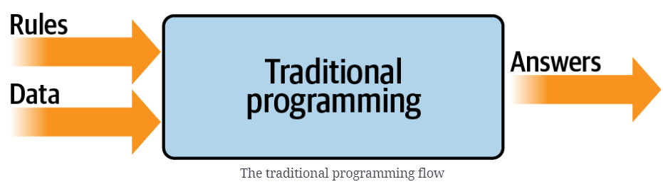
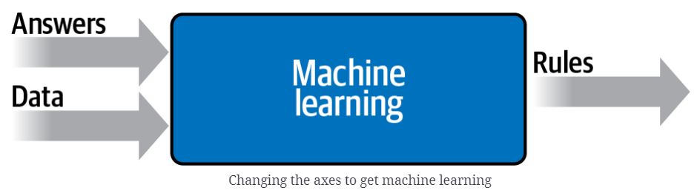
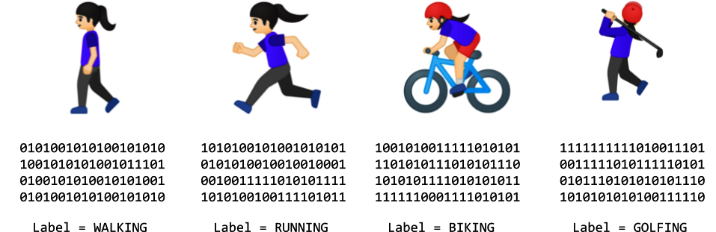
TP and ML
Traditional programming (TP) approach is shown in the Figure. We have rules that act on data and give us answers.
The rules and data are provided to the programme, and you can get an output based on the data structure.
We get lots of data about our scenario, we label that data, and the computer can figure out what the rules are that make one piece of data match a particular label and another piece of data match a different label.
Suppose we collect a lot of instances of this data while they’re doing different activities.
We end up with a scenario of having data that says “This is what walking looks like,” “This is what running looks like,” and so on

Slide 7
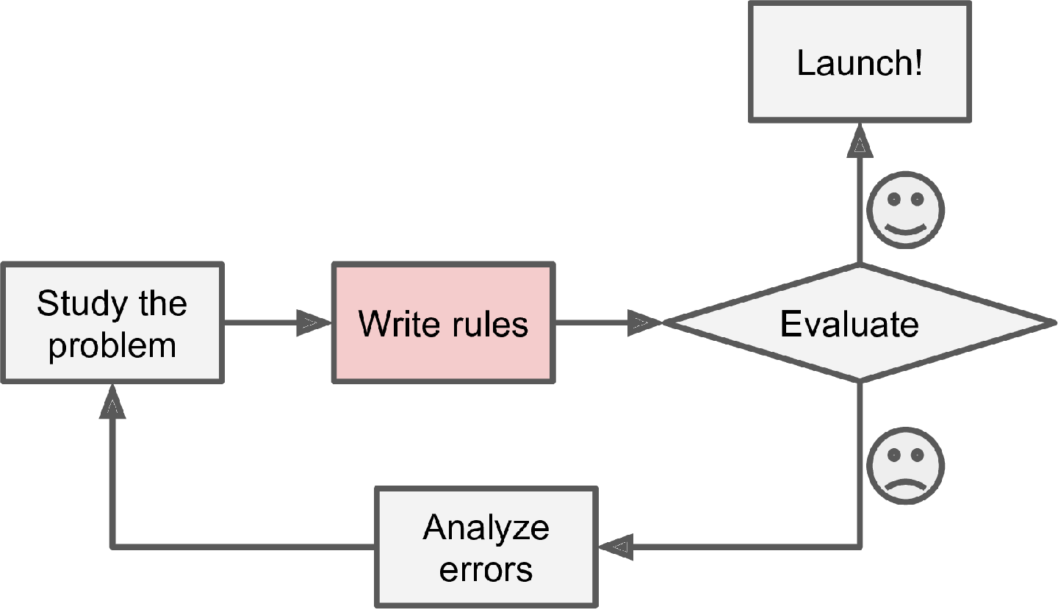
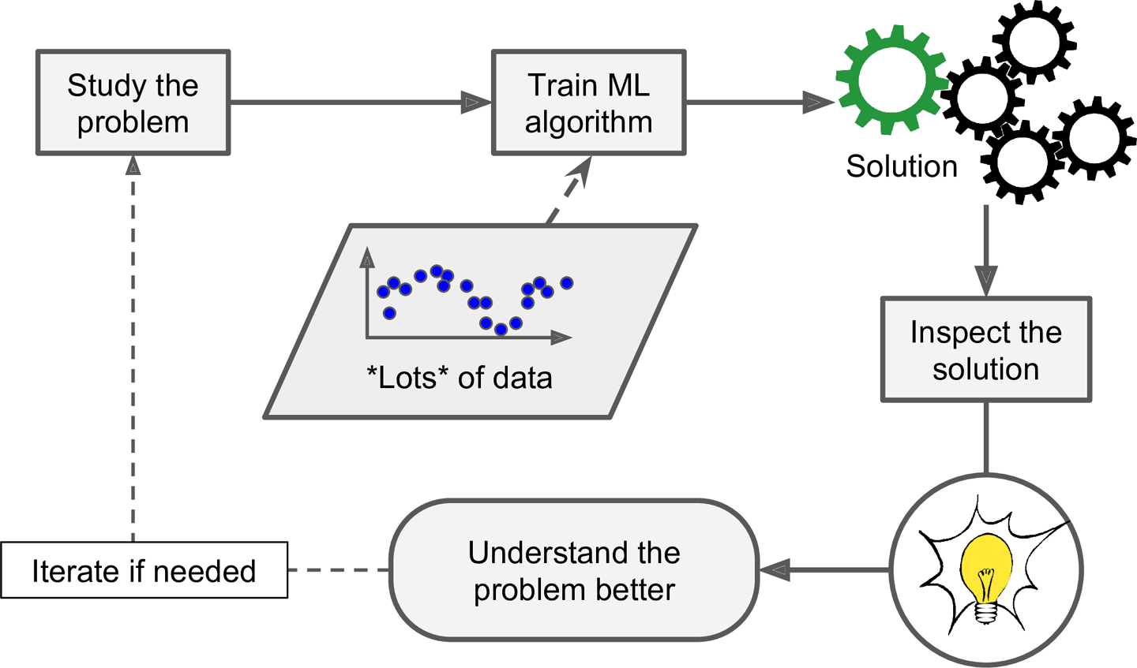
TP and ML
We can develop a spam filter using traditional programming techniques using the following steps as
First we would consider what spam typically looks like. We might notice that some words or phrases (such as “win,” “credit card,” “free,” and “amazing”) tend to come up a lot in the subject line.
We would notice a few other patterns in the sender’s name, the email’s body, and other parts of the email.
We would write a detection algorithm for each of the patterns that we noticed, and your program would flag emails as spam if a number of these patterns were detected.
We would test the program and repeat steps 1 and 2 until it was good enough to launch.
The traditional approach
Machine Learning can help humans learn

Slide 8
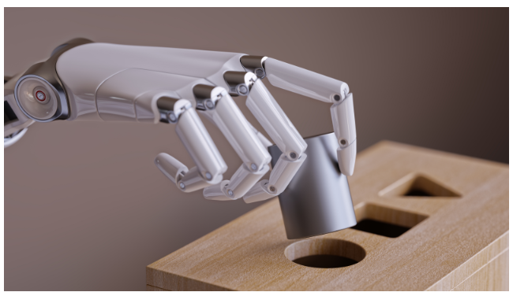
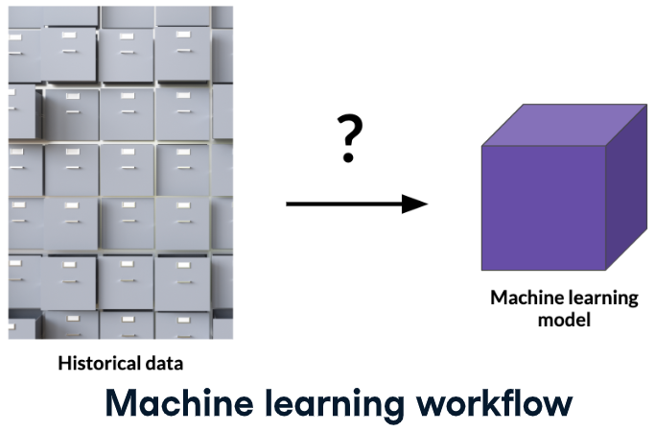
What is Machine Learning?
Machine Learning is the science (and art) of programming computers so they can learn from data.
Machine Learning is the field of study that gives computers the ability to learn without being explicitly programmed. Arthur Samuel, 1959
A set of tools for making inferences and predictions from data.
Predict future events
Will it rain tomorrow?
Yes (70% probability)
Infer the causes of events and behaviors
Why does it rain?
Time of the year, humidity levels, temperature, location etc.
Infer patterns
What are the different types of weather conditions?
Rain, sunny, overcast, fog, etc.

Slide 9
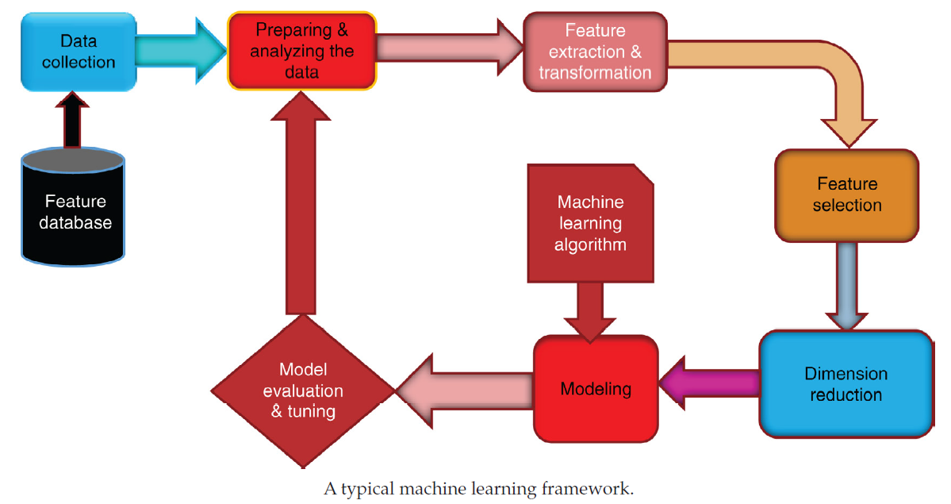
Machine Learning Framework
Machine learning is a unified algorithmic framework designed to identify computational models that accurately describe empirical data and the phenomena underlying it, with little or no human involvement.
A typical machine learning framework is presented as shown in Figure that shows the main stages highlighted in their blocks.
To understand and develop an application utilizing machine learning framework, we use the procedures that are mentioned in the blocks.
Machine Learning can be used to perform a wide array of useful tasks including automatic detection of objects in images, speech recognition, knowledge discovery in the medical sciences, and predictive Analytics and many others.

Slide 10
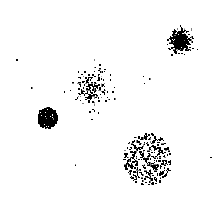

Application Areas of ML
Data
Clustering
Predictive Modeling
Association Rules
Anomaly Detection
Milk

Slide 11
Branches of Machine Learning
Machine learning algorithms fall into two broad categories
Supervised Learning Algorithms are trained with labeled data. In other words, data composed of examples of the desired answers. For instance, a model that identifies fraudulent credit card use would be trained from a dataset with labeled data points of known fraudulent and valid charges. Most machine learning is supervised.
Unsupervised Learning Algorithms are used on data with no labels, and the goal is to find relationships in the data. For instance, we might want to find groupings of customer demographics with similar buying habits.
Reinforcement Learning (RL) is a popular and promising branch of AI that involves making smarter models and agents that can automatically determine ideal behavior based on changing requirements.
Supervised
Learning
Unsupervised
Learning
Semi-supervised
Learning
Reinforcement
Learning
Semi-supervised Learning is a machine learning branch that tries to solve problems with both labeled and unlabeled data with an approach that employs concepts belonging to clustering and classification methods.
Notes:
https://neptune.ai/blog/reinforcement-learning-applications

Slide 12
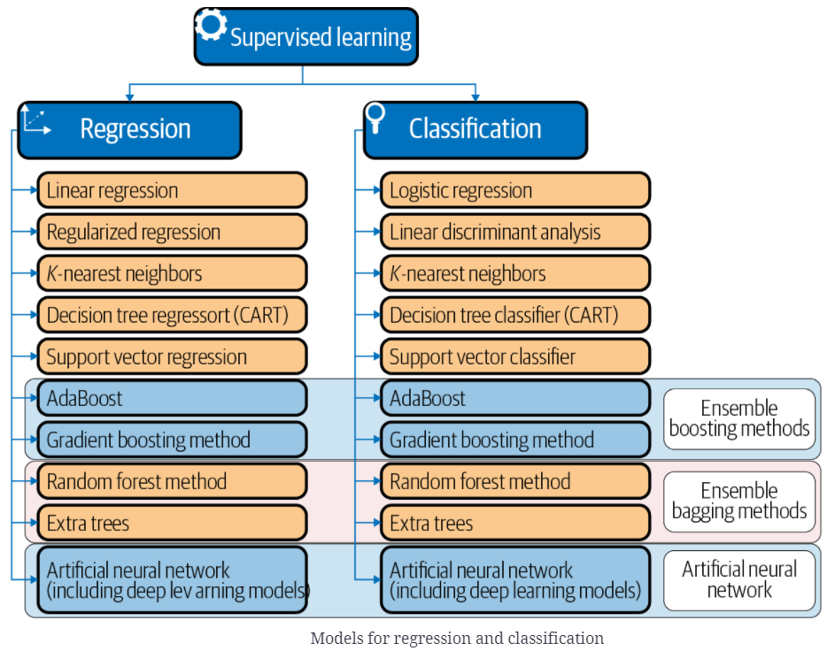
Machine Learning Modelling Regression
Predict a value of a given continuous valued variable based on the values of other variables, assuming a linear or nonlinear model of dependency.
Extensively studied in statistics and neural network fields.
Examples:
Predicting sales amounts of new product based on advertising expenditure.
Predicting wind velocities as a function of temperature, humidity, air pressure, etc.
Time series prediction of stock market indices.
Bootstrap aggregation (Bagging) is an ensemble learning method that is commonly used to reduce variance within a noisy dataset.
Boosting refers to the process of sequentially training weak learners to build a model.
Notes:
Bagging, also known as bootstrap aggregation, is the ensemble learning method that is commonly used to reduce variance within a noisy dataset. In bagging, a random sample of data in a training set is selected with replacement—meaning that the individual data points can be chosen more than once. [https://www.ibm.com/cloud/learn/bagging]. It is a sampling technique in which subsets of the dataset are created with replacement.

Slide 13
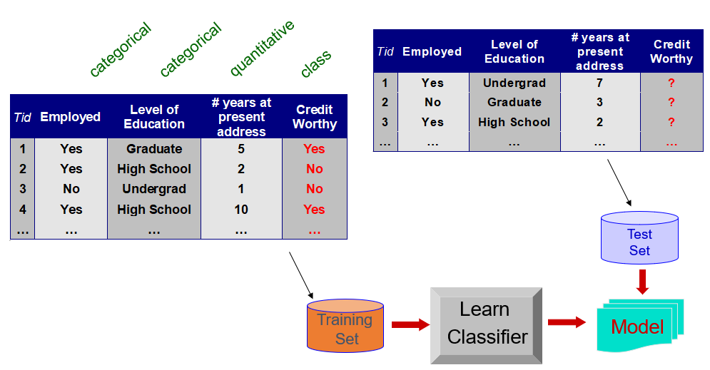
Machine Learning Modelling Classification
Find a model for class attribute as a function of the values of other attributes.
Class
Model for predicting credit worthiness

Slide 14
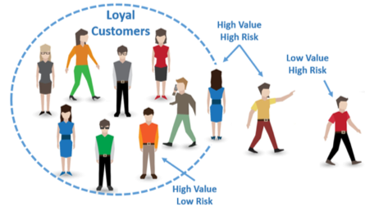

Classification Applications
Fraud Detection
Goal: Predict fraudulent cases in credit card transactions.
Approach:
Use credit card transactions and the information on its account-holder as attributes.
When does a customer buy, what does he/ she buy, how often he/ she pays on time, etc.
Label past transactions as fraud or fair transactions. This forms the class attribute.
Learn a model for the class of the transactions.
Use this model to detect fraud by observing credit card transactions on an account.
Churn prediction for telephone customers
Goal: To predict whether a customer is likely to be lost to a competitor.
Approach:
Use detailed record of transactions with each of the past and present customers, to find attributes.
How often the customer calls, where he/ she calls, what time-of-the day he/ she calls most, his financial status, marital status, etc.
Label the customers as loyal or disloyal.
Find a model for loyalty.

Slide 15
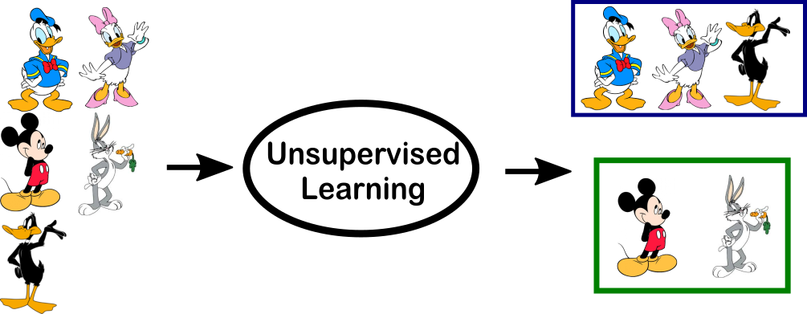
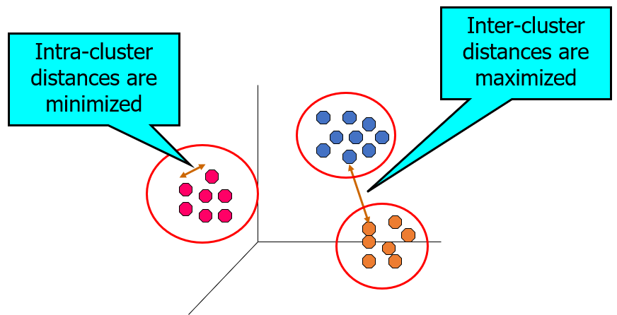
Machine Learning Modelling Clustering
Finding groups of objects such that the objects in a group will be similar (or related) to one another and different from (or unrelated to) the objects in other groups.
In unsupervised learning, as we might guess, the training data is unlabeled. The system tries to learn without a teacher.
The most important unsupervised learning algorithms.
Clustering: K-Means, DBSCAN and Hierarchical Cluster Analysis (HCA).
Anomaly Detection and Novelty Detection: One-class SVM and Isolation Forest.
Visualization and Dimensionality Reduction: Principal Component Analysis (PCA), Locally Linear Embedding (LLE) and t-Distributed Stochastic Neighbor Embedding (t-SNE).
Notes:
Locally Linear Embedding (LLE) is a method for nonlinear dimensionality reduction that is based on the idea of modeling the local structure of the data by reconstructing it from a linear combination of its neighbors.
t-distributed stochastic neighbor embedding (t-SNE) is a statistical method for visualizing high-dimensional data by giving each datapoint a location in a two or three-dimensional map.

Slide 16
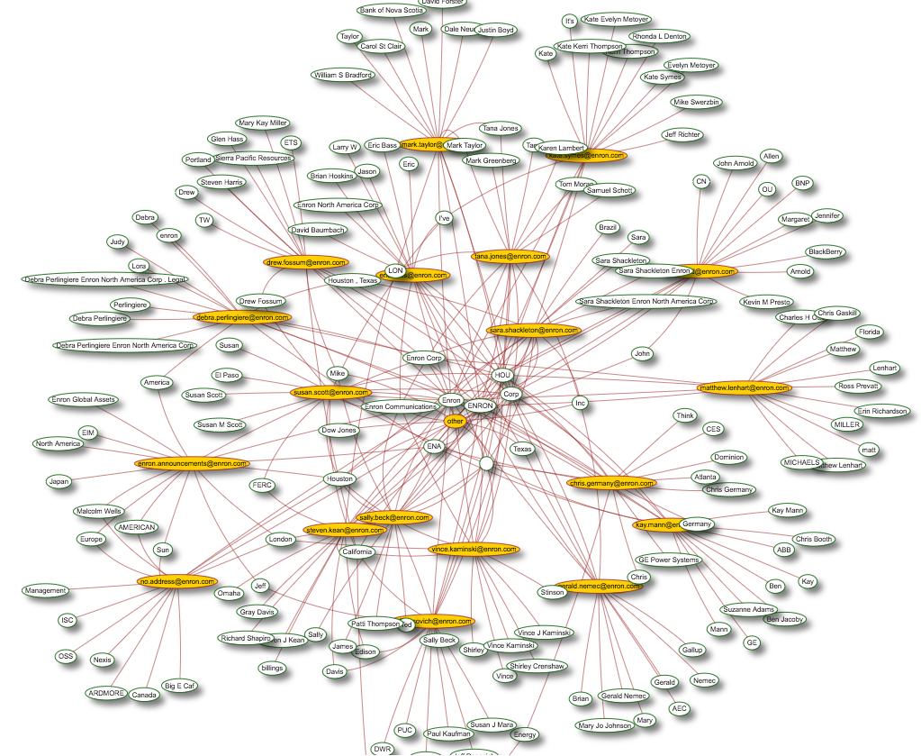
Clustering Applications
Market Segmentation:
Goal: subdivide a market into distinct subsets of customers where any subset may be selected as a market target to be reached with a distinct marketing mix.
Approach:
Collect different attributes of customers based on their geographical and lifestyle related information.
Find clusters of similar customers.
Measure the clustering quality by observing buying patterns of customers in the same cluster vs. those from different clusters.
Document Clustering:
Goal: To find groups of documents that are similar to each other based on the important terms appearing in them.
Approach: To identify frequently occurring terms in each document. Form a similarity measure based on the frequencies of different terms. Use it to cluster.
Enron email dataset

Slide 17
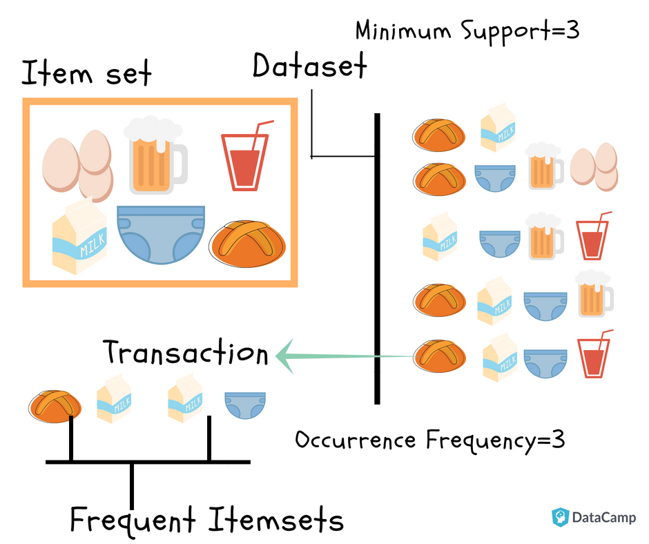

Association Rule Discovery
Given a set of records each of which contain some number of items from a given collection
Produce dependency rules which will predict occurrence of an item based on occurrences of other items.
Rules Discovered:
{Milk} --> {Coke}
{Diaper, Milk} --> {Beer}

Slide 18
Association Analysis Applications
Market-basket analysis
Rules are used for sales promotion, shelf management, and inventory management.
Telecommunication alarm diagnosis
Rules are used to find combination of alarms that occur together frequently in the same time period.
Medical Informatics
Rules are used to find combination of patient symptoms and test results associated with certain diseases.

Slide 19
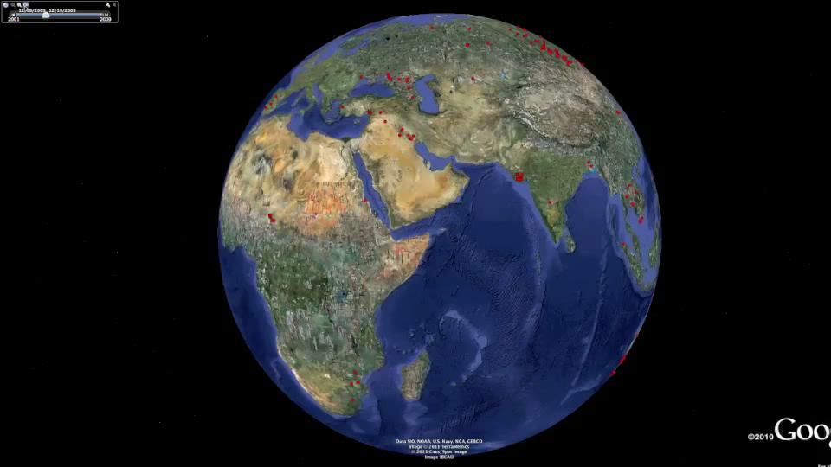
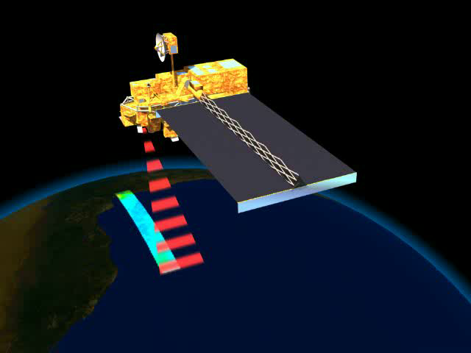
Deviation/Anomaly/Change Detection
Detect significant deviations from normal behavior
Applications:
Credit Card Fraud Detection
Network Intrusion Detection
Identify anomalous behavior from sensor networks for monitoring and surveillance.
Detecting changes in the global forest cover.

Slide 20
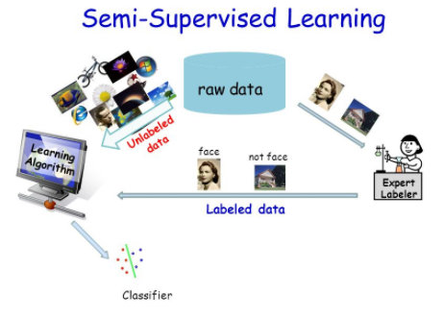
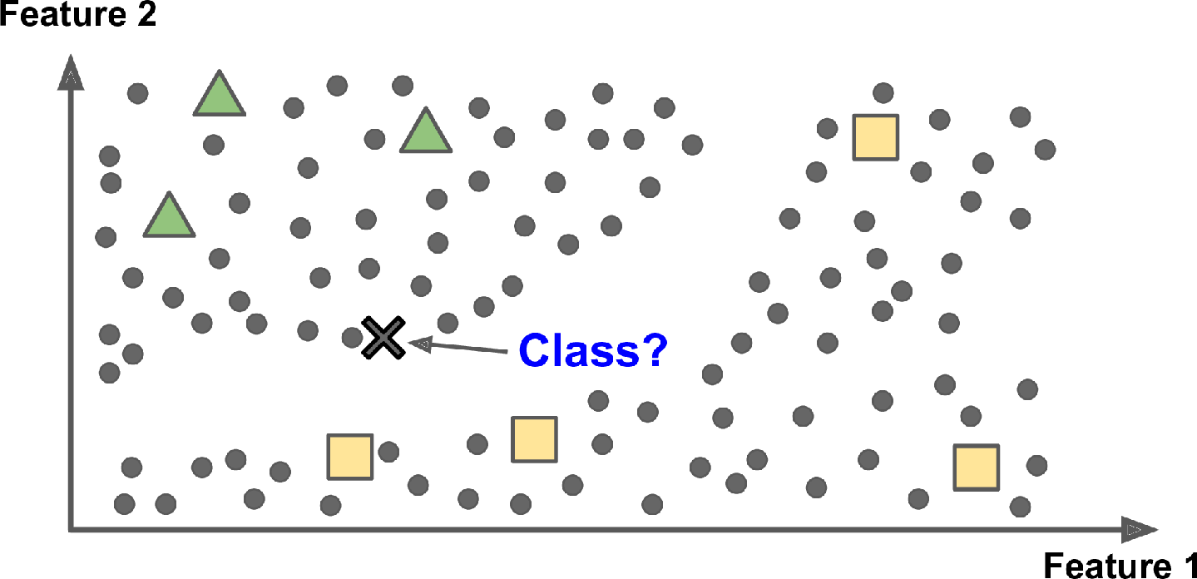
Semi-supervised Learning
Since labeling data is time-consuming and costly, we have plenty of unlabeled instances, and few labeled instances.
Some algorithms can deal with data that’s partially labeled. This is called as the Semi-supervised learning.
Some photo-hosting services, such as Google Photos, are good examples of this.
Once you upload all of your family photos to the service, it automatically recognizes that the same person A shows up in photos 1, 5, and 11, while another person B shows up in photos 2, 5, and 7.
This is the unsupervised part of the algorithm (clustering). Now all the system needs is for you to tell it who these people are. Add one label per person and it is able to name everyone in every photo, which is useful for searching photos.
Semi-supervised learning with two classes (triangles and squares): the unlabeled examples (circles) help classify a new instance (the cross) into the triangle class rather than the square class, even though it is closer to the labeled squares

Slide 21


Reinforcement Learning
Consider we are teaching the dog to catch a ball, when we throw a ball, the dog catches a ball, we will give a cookie. If it fails to catch a dog, we will not give a cookie. So the dog will figure out what actions it does that made it receive a cookie and repeat that action.
Similarly, in an RL environment, we will not teach the agent what to do or how to do, but we will give feedback to the agent for each action it does. The feedback may be positive (reward) or negative (punishment).
The learning system which receives the punishment will improve itself. It is a trial-and-error process. The reinforcement learning algorithm retains outputs that maximize the received reward over time.
In the above analogy, the dog represents the agent, giving a cookie to the dog on catching a ball is a reward and not giving a cookie is punishment.
It depends on out policy that we should give a reward after each step or after completion of some number of steps.
A RL agent can explore for different actions which might give a good reward, or it can (exploit) use the previous action which resulted in a good reward. If the RL agent explores different actions, there is a great possibility to get a poor reward.

Slide 22
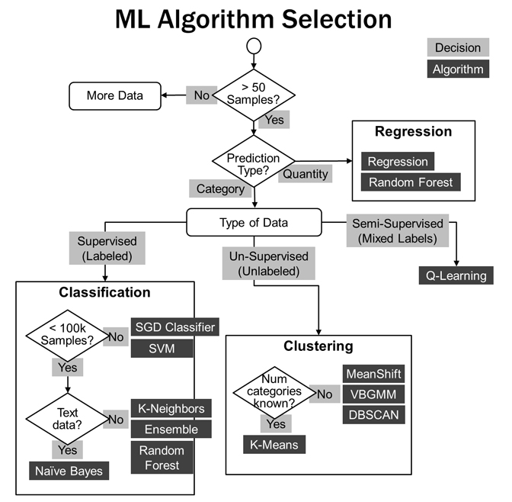
ML Algorithm Selection
The flow chart is used to show the selection of Machine learning algorithm based on the data.
It is clear from the flow chart that the three major kinds of algorithms are considered as important in the machine learning.
It is the responsibility of Data Scientist to select an appropriate ML algorithm to provide an accurate results for the relevant problem.

Slide 23
Cross Industry Standard Process CRISP-DM
Cross-Industry Standard Process for Data Mining (CRISP-DM) developed in 1996
Fits data mining into the general problem-solving strategy of business/ research unit
Industry, tool and application neutral
Data mining projects follow iterative, adaptive life cycle consisting of 6 phases
Business / Research Understanding Phase
Data Understanding Phase
Deployment Phase
Data Preparation Phase
Evaluation Phase
Modeling Phase
CRISP-DM Lifecycle
Iterative CRIP-DM process is shown in outer circle
Most significant dependencies between phases shown
Next phase depends on results from preceding phase
Returning to earlier phase possible before moving forward

Slide 24
Cross Industry Standard Process CRISP-DM
Business/ Research Understanding Phase
Define project requirements and objectives
Translate objectives into data exploration problem definition
Prepare preliminary strategy to meet objectives
Data Understanding Phase
Collect data
Perform exploratory data analysis (EDA)
Assess data quality
Optionally, select interesting subsets
Data Preparation Phase
Prepares for modeling in subsequent phases
Select cases and variables appropriate for analysis
Cleanse and prepare data so it is ready for modeling tools
Perform transformation of certain variables, if needed
Modeling Phase
Select and apply one or more modeling techniques
Calibrate model settings to optimize results
Evaluation Phase
Evaluate one or more models for effectiveness
Determine whether defined objectives achieved
Make decision regarding data exploration results before deploying to field
Deployment Phase
Make use of models created
Simple deployment example: generate report
Complex deployment example: implement parallel data exploration effort in another department
In businesses, customer often carries out deployment based on your model

Slide 25
Resources/ References
Hands-On Machine Learning with Scikit-Learn, Keras, and TensorFlow, 2nd Edition, Aurélien Géron, O'Reilly Media, September 2019, ISBN: 9781492032649.
Introduction to Machine Learning with Python, Andreas C. Müller and Sarah Guido, O'Reilly Media, Inc. October 2016.
Data Mining And Machine Learning, Fundamental Concepts And Algorithms, MOHAMMED J. Zaki, Wagner Meira, Jr., Cambridge CB2 8BS, United Kingdom, 2020.
Discovering Knowledge In Data: An Introduction To Data Exploration, Second Edition, By Daniel Larose And Chantal Larose, John Wiley And Sons, Inc., 2014.
UCI Repository: http://www.ics.uci.edu/~mlearn/MLRepository.html
Statlib: http://lib.stat.cmu.edu/
Some images are used from Google search repository (https://www.google.ie/search) to enhance the level of learning.
Copyright Notice The following material has been communicated to you by or on behalf of CCT College Dublin in accordance with the Copyright and Related Rights Act 2000 (the Act). The material may be subject to copyright under the Act and any further reproduction, communication or distribution of this material must be in accordance with the Act. Do not remove this notice

